Slide 1


DATA 225 Database Systems for Analytics September 18 Class Meeting
Department of Applied Data Science San Jose State University Fall 2023 Instructor: Ron Mak
www.cs.sjsu.edu/~mak

Slide 2
This Evening
Constraint management
Named constraints
Table creation with constraints
Table loading with constraints
Dropping tables with constraints
ALTER TABLE statement
Break
Functional dependencies
Update anomalies and normalization
Normal forms: 1NF, 2NF, and 3NF

Slide 3
Constraint Rules for Relational Tables
Primary key constraint
Each relation must have a primary key (a column or set of columns) whose value is unique for each row.
Entity integrity constraint
No primary key column can have a null value.
Referential integrity constraint
In each row containing a foreign key, either the value of the foreign key must match one of the values of the primary key of the referred table, or the foreign key is null.

Slide 4
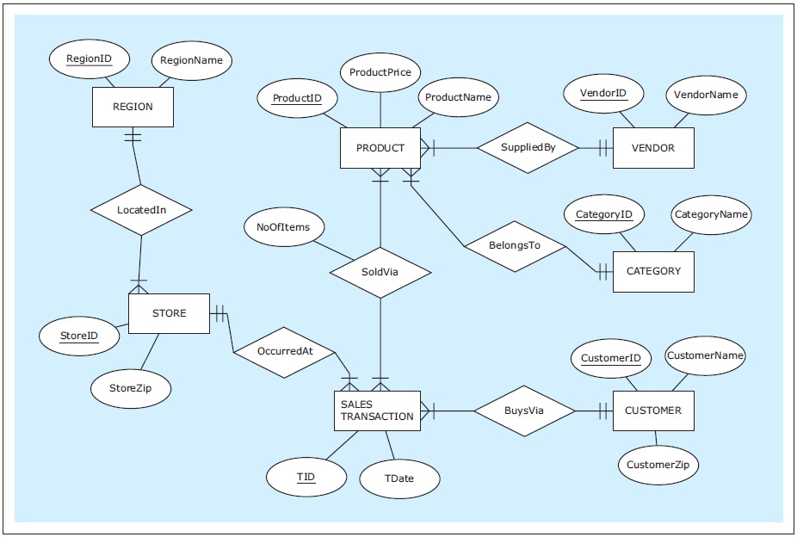
CREATE TABLE Examples
ZAGI Retail Company
Sales Department Database
Database Systems
by Jukić, Vrbsky, & Nestorov
Pearson 2014
ISBN 978-0-13-257567-6

Slide 5
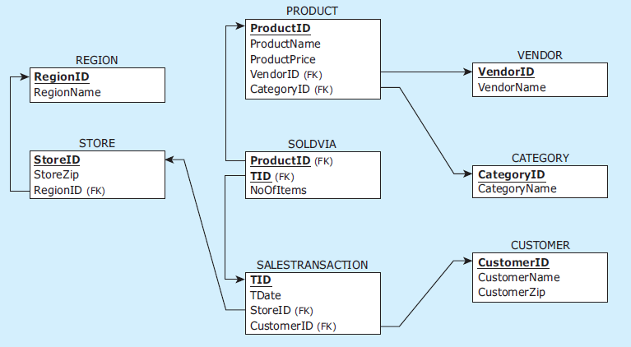
CREATE TABLE Examples, cont’d
ZAGI Retail Company
Sales Department Database
Database Systems
by Jukić, Vrbsky, & Nestorov
Pearson 2014
ISBN 978-0-13-257567-6

Slide 6
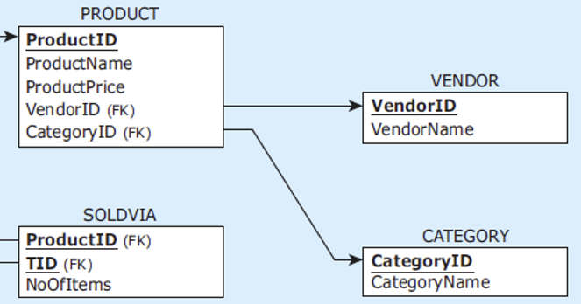
CREATE TABLE Examples, cont’d
data types
CREATE TABLE vendor
( vendorid CHAR(2) NOT NULL,
vendorname VARCHAR(25) NOT NULL,
PRIMARY KEY (vendorid)
);
CREATE TABLE category
( categoryid CHAR(2) NOT NULL,
categoryname VARCHAR(25) NOT NULL,
PRIMARY KEY (categoryid)
);
CREATE TABLE product
( productid CHAR(3) NOT NULL,
productname VARCHAR(25) NOT NULL,
productprice NUMERIC(7,2) NOT NULL,
vendorid CHAR(2) NOT NULL,
categoryid CHAR(2) NOT NULL,
PRIMARY KEY (productid),
FOREIGN KEY (vendorid) REFERENCES vendor(vendorid),
FOREIGN KEY (categoryid) REFERENCES category(categoryid)
);
column constraints
table constraints

Slide 7
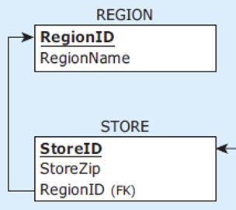
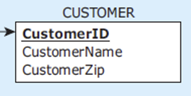
CREATE TABLE Examples, cont’d
CREATE TABLE region
( regionid CHAR(1) NOT NULL,
regionname VARCHAR(25) NOT NULL,
PRIMARY KEY (regionid)
);
CREATE TABLE store
( storeid VARCHAR(3) NOT NULL,
storezip CHAR(5) NOT NULL,
regionid CHAR(1) NOT NULL,
PRIMARY KEY (storeid),
FOREIGN KEY (regionid) REFERENCES region(regionid)
);
CREATE TABLE customer
( customerid CHAR(7) NOT NULL,
customername VARCHAR(15) NOT NULL,
customerzip CHAR(5) NOT NULL,
PRIMARY KEY (customerid)
);

Slide 8
CREATE TABLE Examples, cont’d
CREATE TABLE salestransaction
( tid VARCHAR(8) NOT NULL,
customerid CHAR(7) NOT NULL,
storeid VARCHAR(3) NOT NULL,
tdate DATE NOT NULL,
PRIMARY KEY (tid),
FOREIGN KEY (customerid)
REFERENCES customer(customerid),
FOREIGN KEY (storeid)
REFERENCES store(storeid)
);
CREATE TABLE soldvia
( productid CHAR(3) NOT NULL,
tid VARCHAR(8) NOT NULL,
noofitems INT NOT NULL,
PRIMARY KEY (productid, tid),
FOREIGN KEY (productid) REFERENCES product(productid),
FOREIGN KEY (tid) REFERENCES salestransaction(tid)
);
linking table
linking table
composite key

Slide 9
DROP TABLE
Referential integrity prevents deletion of a table that is referenced by foreign keys.
Invalid sequence:
DROP TABLE region;
DROP TABLE store;
DROP TABLE salestransaction;
DROP TABLE product;
DROP TABLE vendor;
DROP TABLE category;
DROP TABLE customer;
DROP TABLE soldvia;
Why?
Database Systems
by Jukić, Vrbsky, & Nestorov
Pearson 2014
ISBN 978-0-13-257567-6

Slide 10
DROP TABLE, cont’d
Valid sequence:
DROP TABLE soldvia;
DROP TABLE salestransaction;
DROP TABLE store;
DROP TABLE product;
DROP TABLE vendor;
DROP TABLE region;
DROP TABLE category;
DROP TABLE customer;
Database Systems
by Jukić, Vrbsky, & Nestorov
Pearson 2014
ISBN 978-0-13-257567-6

Slide 11
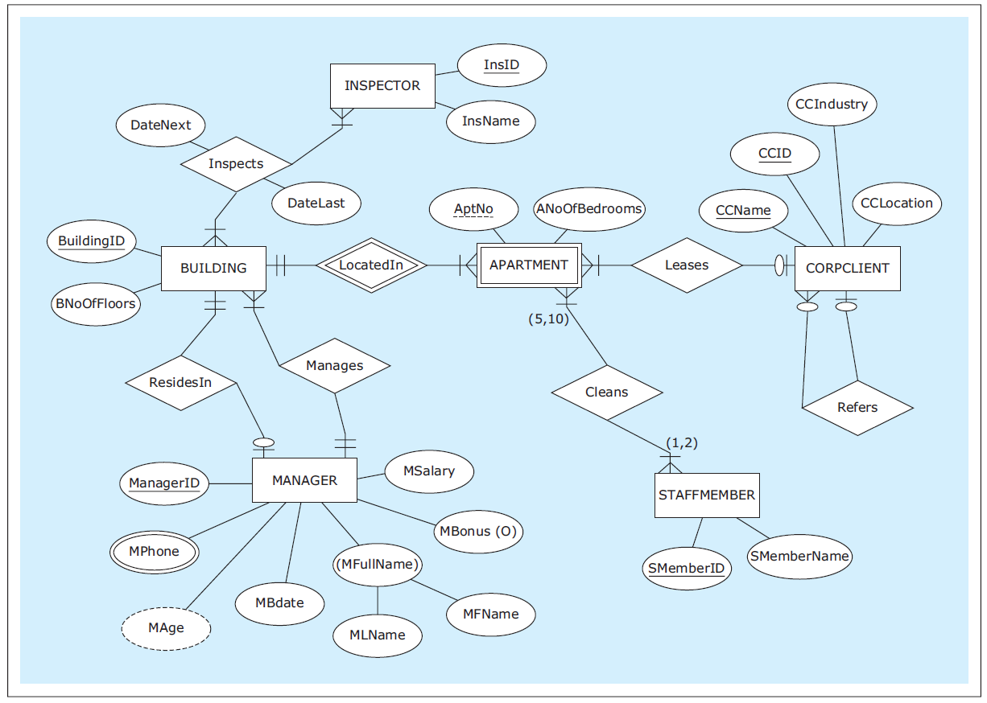
CREATE TABLE with Constraints
HAFH Realty Company
Property Management Database
Database Systems
by Jukić, Vrbsky, & Nestorov
Pearson 2014
ISBN 978-0-13-257567-6

Slide 12
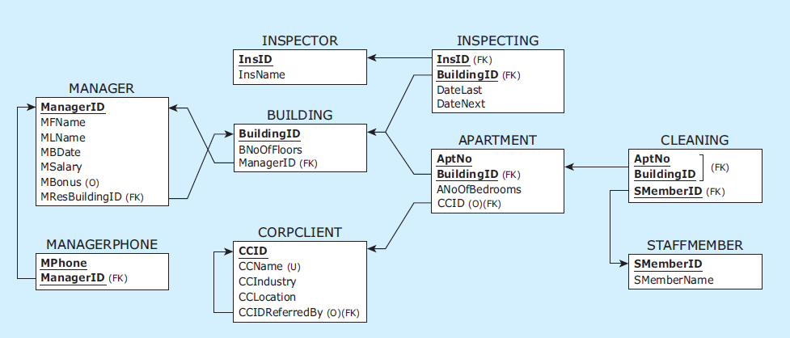
CREATE TABLE with Constraints, cont’d
HAFH Realty Company
Property Management Database
MANAGER and BUILDING
reference each other.
optional
unique
Unary relationship
Database Systems
by Jukić, Vrbsky, & Nestorov
Pearson 2014
ISBN 978-0-13-257567-6

Slide 13
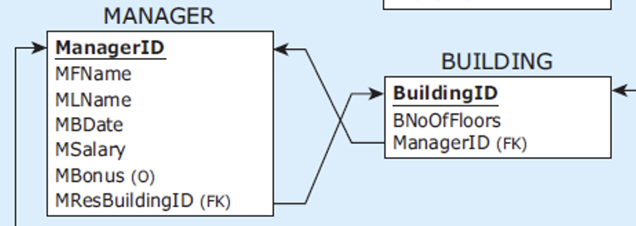
CREATE TABLE with Constraints, cont’d
CREATE TABLE manager
( managerid CHAR(4) NOT NULL,
mfname VARCHAR(15) NOT NULL,
mlname VARCHAR(15) NOT NULL,
mbdate DATE NOT NULL,
msalary NUMERIC(9,2) NOT NULL,
mbonus NUMERIC(9,2),
mresbuildingid CHAR(3),
PRIMARY KEY (managerid)
);
CREATE TABLE building
( buildingid CHAR(3) NOT NULL,
bnooffloors INT NOT NULL,
bmanagerid CHAR(4) NOT NULL,
PRIMARY KEY (buildingid),
FOREIGN KEY (bmanagerid) REFERENCES manager(managerid)
);
Bonuses are optional.
Initially optional and
not a foreign key.
BUILDING not yet created!

Slide 14
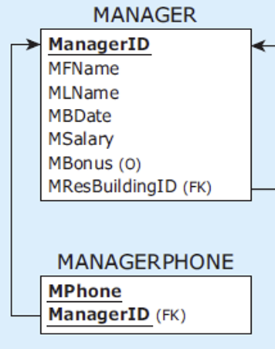
CREATE TABLE with Constraints, cont’d
CREATE TABLE managerphone
( managerid CHAR(4) NOT NULL,
mphone CHAR(11) NOT NULL,
PRIMARY KEY (managerid, mphone),
FOREIGN KEY (managerid) REFERENCES manager(managerid)
);

Slide 15
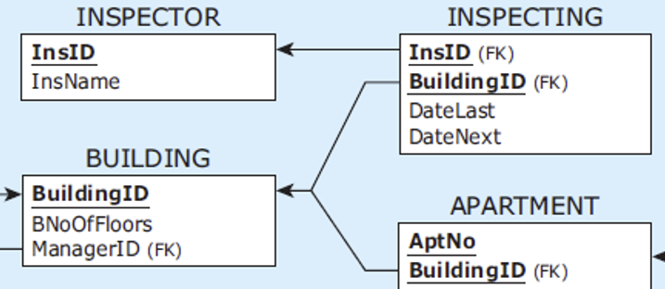
CREATE TABLE with Constraints, cont’d
CREATE TABLE inspector
( insid CHAR(3) NOT NULL,
insname VARCHAR(15) NOT NULL,
PRIMARY KEY (insid)
);
CREATE TABLE inspecting
( insid CHAR(3) NOT NULL,
buildingid CHAR(3) NOT NULL,
datelast DATE NOT NULL,
datenext DATE NOT NULL,
PRIMARY KEY (insid, buildingid),
FOREIGN KEY (insid) REFERENCES inspector(insid),
FOREIGN KEY (buildingid) REFERENCES building(buildingid)
);

Slide 16
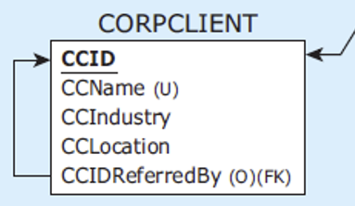
CREATE TABLE with Constraints, cont’d
CREATE TABLE corpclient
( ccid CHAR(4) NOT NULL,
ccname VARCHAR(25) NOT NULL,
ccindustry VARCHAR(25) NOT NULL,
cclocation VARCHAR(25) NOT NULL,
ccidreferredby CHAR(4),
PRIMARY KEY (ccid),
UNIQUE (ccname),
FOREIGN KEY (ccidreferredby) REFERENCES corpclient(ccid)
);

Slide 17
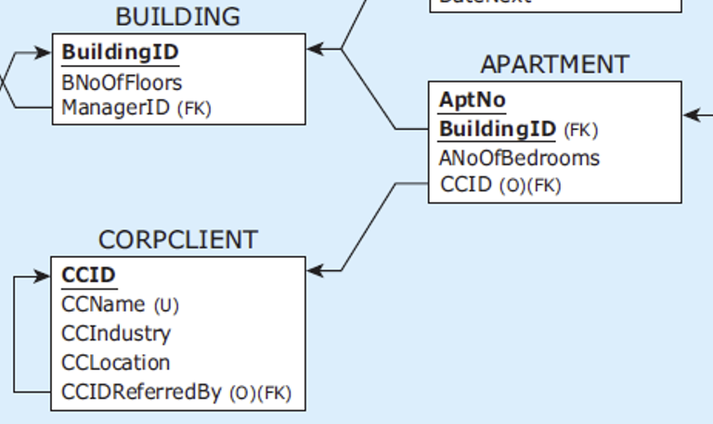
CREATE TABLE with Constraints, cont’d
CREATE TABLE apartment
( buildingid CHAR(3) NOT NULL,
aptno CHAR(5) NOT NULL,
anoofbedrooms INT NOT NULL,
ccid CHAR(4),
PRIMARY KEY (buildingid, aptno),
FOREIGN KEY (buildingid) REFERENCES building(buildingid),
FOREIGN KEY (ccid) REFERENCES corpclient(ccid)
);
CREATE TABLE staffmember
( smemberid CHAR(4) NOT NULL,
smembername VARCHAR(15) NOT NULL,
PRIMARY KEY (smemberid)
);

Slide 18
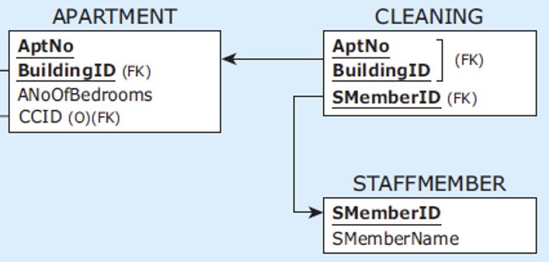
CREATE TABLE with Constraints, cont’d
CREATE TABLE cleaning
( buildingid CHAR(3) NOT NULL,
aptno CHAR(5) NOT NULL,
smemberid CHAR(4) NOT NULL,
CONSTRAINT cleaningpk
PRIMARY KEY (buildingid, aptno, smemberid),
CONSTRAINT cleaningfk1
FOREIGN KEY (buildingid, aptno)
REFERENCES apartment(buildingid, aptno),
CONSTRAINT cleaningfk2
FOREIGN KEY (smemberid)
REFERENCES staffmember(smemberid)
);
Named
constraints

Slide 19
INSERT INTO with Constraints
CREATE TABLE manager
( managerid CHAR(4) NOT NULL,
mfname VARCHAR(15) NOT NULL,
mlname VARCHAR(15) NOT NULL,
mbdate DATE NOT NULL,
msalary NUMERIC(9,2) NOT NULL,
mbonus NUMERIC(9,2),
mresbuildingid CHAR(3),
PRIMARY KEY (managerid)
);
mresbuildingid
INSERT INTO manager VALUES
('M12', 'Boris', 'Grant', '20/Jun/1980', 60000, null, null);
INSERT INTO manager VALUES
('M23', 'Austin', 'Lee', '30/Oct/1975', 50000, 5000, null);
INSERT INTO manager VALUES
('M34', 'George', 'Sherman', '11/Jan/1976', 52000, 2000, null);
INSERT INTO managerphone VALUES ('M12','555-2222');
INSERT INTO managerphone VALUES ('M12','555-3232');
INSERT INTO managerphone VALUES ('M23','555-9988');
INSERT INTO managerphone VALUES ('M34','555-9999');
INSERT INTO building VALUES ('B1', '5', 'M12');
INSERT INTO building VALUES ('B2', '6', 'M23');
INSERT INTO building VALUES ('B3', '4', 'M23');
INSERT INTO building VALUES ('B4', '4', 'M34’);
Why
NULL?

Slide 20
INSERT INTO with Constraints, cont’d
CREATE TABLE manager
( managerid CHAR(4) NOT NULL,
mfname VARCHAR(15) NOT NULL,
mlname VARCHAR(15) NOT NULL,
mbdate DATE NOT NULL,
msalary NUMERIC(9,2) NOT NULL,
mbonus NUMERIC(9,2),
mresbuildingid CHAR(3),
PRIMARY KEY (managerid)
);
ALTER TABLE manager
ADD CONSTRAINT fkresidesin
FOREIGN KEY (mresbuildingid)
REFERENCES building (buildingid);
UPDATE manager
SET mresbuildingid = 'B1'
WHERE managerid = 'M12';
UPDATE manager
SET mresbuildingid = 'B2'
WHERE managerid = 'M23';
UPDATE manager
SET mresbuildingid = 'B4'
WHERE managerid = 'M34';
ALTER TABLE manager
MODIFY (mresbuildingid NOT NULL);

Slide 21
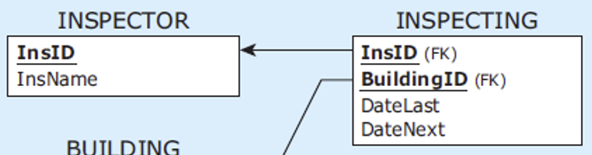
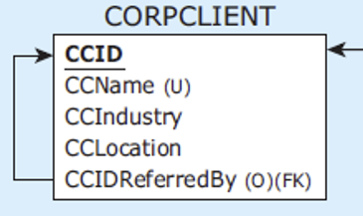
INSERT INTO with Constraints, cont’d
INSERT INTO inspector VALUES ('I11', 'Jane');
INSERT INTO inspector VALUES ('I22', 'Niko');
INSERT INTO inspector VALUES ('I33', 'Mick');
INSERT INTO inspecting VALUES ('I11','B1','15/May/2012','14/May/2013');
INSERT INTO inspecting VALUES ('I11','B2','17/Feb/2013','17/May/2013');
INSERT INTO inspecting VALUES ('I22','B2','17/Feb/2013','17/May/2013');
INSERT INTO inspecting VALUES ('I22','B3','11/Jan/2013','11/Jan/2014');
INSERT INTO inspecting VALUES ('I33','B3','12/Jan/2013','12/Jan/2014');
INSERT INTO inspecting VALUES ('I33','B4','11/Jan/2013','11/Jan/2014');
INSERT INTO corpclient VALUES
('C111', 'BlingNotes', 'Music', 'Chicago', null);
INSERT INTO corpclient VALUES
('C222', 'SkyJet', 'Airline', 'Oak Park', 'C111');
INSERT INTO corpclient VALUES
('C777', 'WindyCT', 'Music', 'Chicago', 'C222');
INSERT INTO corpclient VALUES
('C888', 'SouthAlps', 'Sports', 'Rosemont', 'C777');

Slide 22
INSERT INTO with Constraints, cont’d
INSERT INTO apartment VALUES ('B1', '21', 1, 'C111');
INSERT INTO apartment VALUES ('B1', '41', 1, null);
INSERT INTO apartment VALUES ('B2', '11', 2, 'C222');
INSERT INTO apartment VALUES ('B2', '31', 2, null);
INSERT INTO apartment VALUES ('B3', '11', 2, 'C777');
INSERT INTO apartment VALUES ('B4', '11', 2, 'C777');
INSERT INTO staffmember VALUES ('5432', 'Brian');
INSERT INTO staffmember VALUES ('9876', 'Boris');
INSERT INTO staffmember VALUES ('7652', 'Caroline');
INSERT INTO cleaning VALUES ('B1', '21', '5432');
INSERT INTO cleaning VALUES ('B1', '41', '9876');
INSERT INTO cleaning VALUES ('B2', '11', '9876');
INSERT INTO cleaning VALUES ('B2', '31', '5432');
INSERT INTO cleaning VALUES ('B3', '11', '5432');
INSERT INTO cleaning VALUES ('B4', '11', '7652');

Slide 23
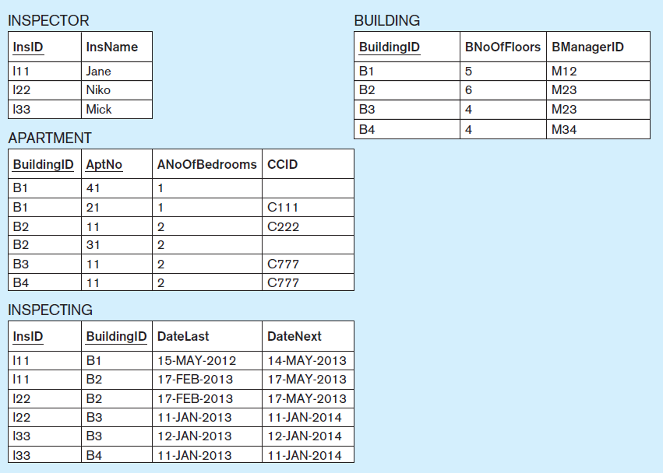
INSERT INTO with Constraints, cont’d
Database Systems
by Jukić, Vrbsky, & Nestorov
Pearson 2014
ISBN 978-0-13-257567-6

Slide 24
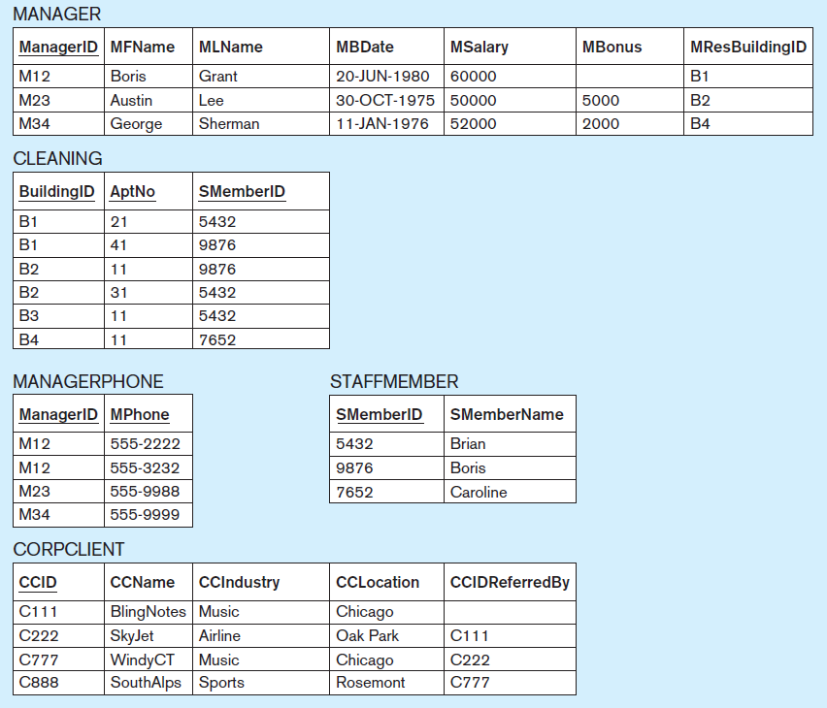
INSERT INTO with Constraints, cont’d
Database Systems
by Jukić, Vrbsky, & Nestorov
Pearson 2014
ISBN 978-0-13-257567-6

Slide 25
DROP TABLE with Constraints
You must drop the tables and constraints in the correct order!
Otherwise, you might violate the referential integrity constraint.
DROP TABLE cleaning; DROP TABLE staffmember; DROP TABLE apartment; DROP TABLE corpclient; DROP TABLE inspecting; DROP TABLE inspector; DROP TABLE managerphone;
At this point, why can’t we drop the manager
and building tables?
ALTER TABLE manager DROP CONSTRAINT fkresidesin;
This why you
name constraints!
DROP TABLE building; DROP TABLE manager;

Slide 26
Break

Slide 27
Database Update Operations
Insert operation
Enter new data into a table.
Delete operation
Remove data from a table.
Modify operation
Change existing data in a table.

Slide 28
Update Anomalies
Insertion anomaly
Deletion anomaly
Modification anomaly
Goal: Remove data redundancies (repeated data).

Slide 29
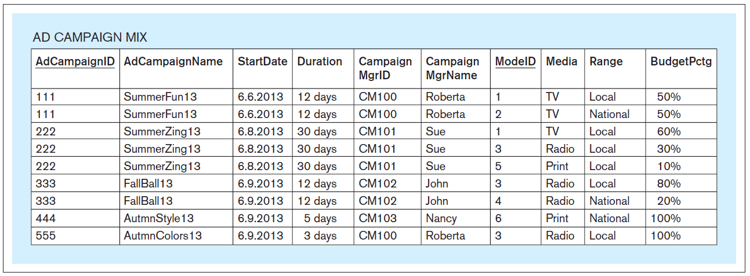
A Table Containing Redundant Data
Primary key: AdCampainID, ModeID
Can you spot the data redundancies?
Database Systems
by Jukić, Vrbsky, & Nestorov
Pearson 2014
ISBN 978-0-13-257567-6

Slide 30
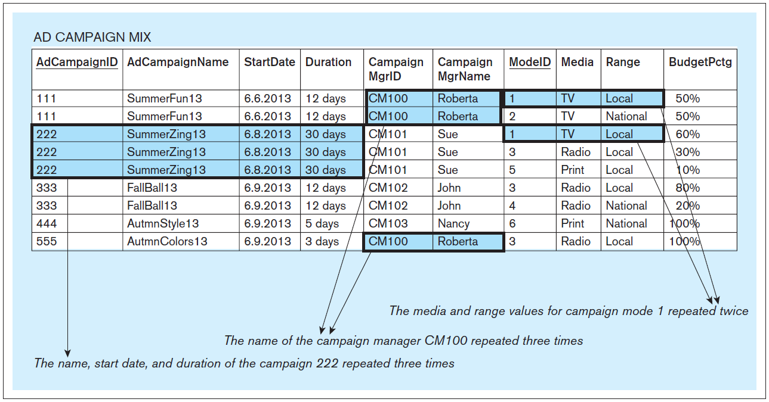
A Table Containing Redundant Data, cont’d
Database Systems
by Jukić, Vrbsky, & Nestorov
Pearson 2014
ISBN 978-0-13-257567-6

Slide 31
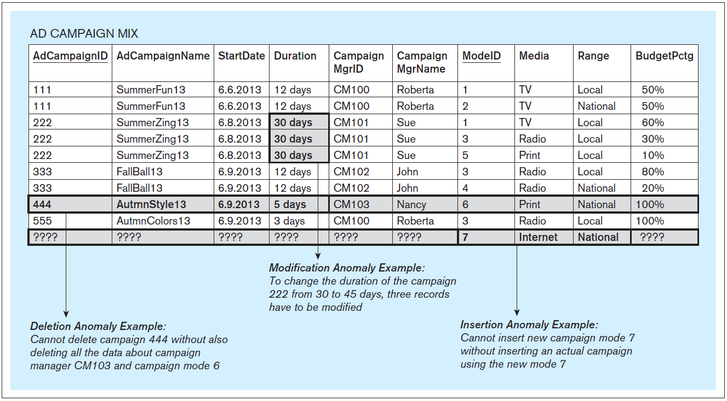
Update Anomalies, cont’d
Database Systems
by Jukić, Vrbsky, & Nestorov
Pearson 2014
ISBN 978-0-13-257567-6

Slide 32
Normalization
Normalize tables to eliminate update anomalies.
Normalization is based on the concept of functional dependencies.

Slide 33
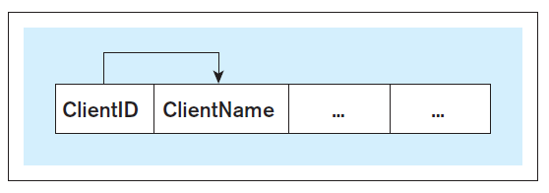
Functional Dependencies
Functional dependency: The value of one or more columns in each row of a table uniquely determines the value of some other column(s) in the same row.
Write A → B
Column(s) A functionally determines column(s) B.
Column(s) B is functionally dependent on column(s) A.
ClientId → ClientName
Database Systems
by Jukić, Vrbsky, & Nestorov
Pearson 2014
ISBN 978-0-13-257567-6

Slide 34
Functional Dependencies, cont’d
In the functional dependency A → B, A is the determinant and B is the dependent.
Note that A → B does not imply that B → A.
In a table, find the functional dependences by:
Inspection: Are the values in any column(s) uniquely determined by the values of any other column(s)?
Table description: The description of the rows and columns of the table can imply functional dependencies.

Slide 35
Functional Dependencies, cont’d
Database Systems
by Jukić, Vrbsky, & Nestorov
Pearson 2014
ISBN 978-0-13-257567-6
AdCampaignID | A unique ID for each ad campaign.
AdCampaignName | A unique name for each ad campaign.
StartDate | Starting date for the ad campaign. More than one campaign can start on the same date.
Duration | Duration of the ad campaign. More than one campaign can have the same duration.
CampaignMgrID | A unique ID for each campaign manager. Each campaign has only one manager. One manager can manage multiple campaigns.
CampaignMgrName | Multiple managers can have the same name.
ModeID | A unique ID for the campaign mode.
Media | Media type of the campaign mode. Each campaign mode has only one media, but the same media can be used by more than one mode.
Range | Range of the campaign mode. Each campaign mode has only one range, but the same range can be used by more than one mode.
BudgetPctg | Budget percentage allocated by a particular ad campaign for a particular campaign modus.

Slide 36
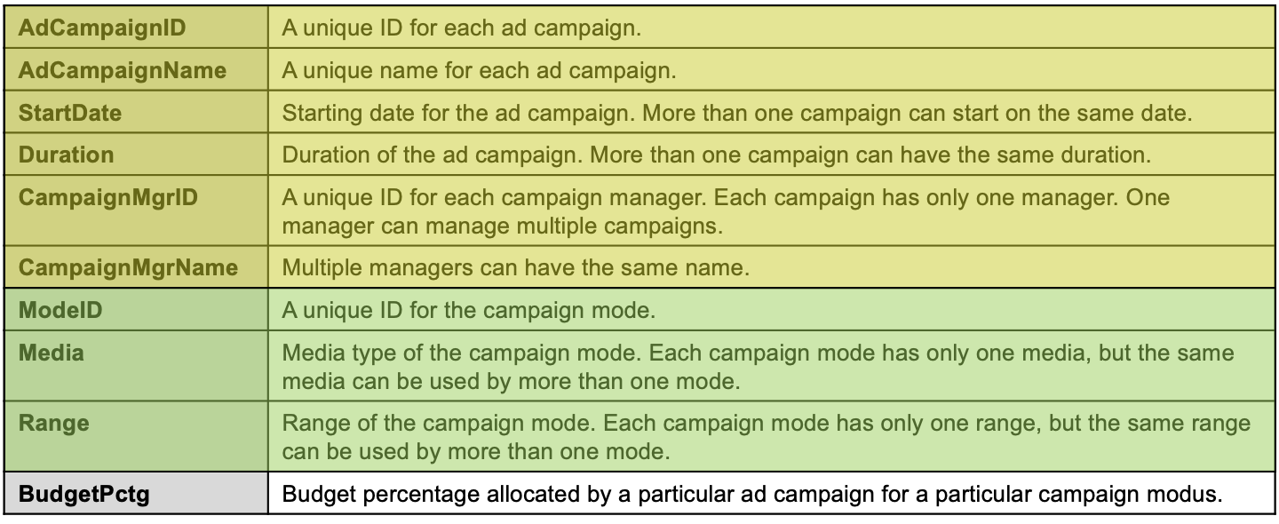
Partial Functional Dependency
Recall the table’s composite primary key (AdCampaignId, ModeId).
A partial functional dependency occurs when a table column is functionally dependent on a component of a composite primary key.
AdCampaignID
AdCampaignName
StartDate
Duration
CampaignMgrID
CampaignMgrName
ModeID
Media
Range
BudgetPctg
AdCampaignID → AdCampaignName, StartDate, Duration, CampaignMgrID CampainMgrName
ModeId → Media, Range
Database Systems
by Jukić, Vrbsky, & Nestorov
Pearson 2014
ISBN 978-0-13-257567-6

Slide 37
Full Key Functional Dependency
A full key functional dependency occurs when a table column is functionally dependent on the primary key and not partially dependent on any separate component of the primary key.
In other words, the dependents of the full key are not already dependents of a partial key.
AdCampaignID
AdCampaignName
StartDate
Duration
CampaignMgrID
CampaignMgrName
ModeID
Media
Range
BudgetPctg
AdCampaignID, ModeID → BudgetPctg
Database Systems
by Jukić, Vrbsky, & Nestorov
Pearson 2014
ISBN 978-0-13-257567-6

Slide 38
Transitive Functional Dependency
A transitive functional dependency occurs when a nonkey column is functionally dependent on another nonkey column.
AdCampaignID
AdCampaignName
StartDate
Duration
CampaignMgrID
CampaignMgrName
ModeID
Media
Range
BudgetPctg
CampaignMgrID → CampaignMgrName
It’s “transitive” because AdCampaignID → CampaignMgrID → CampaignMgrName
Database Systems
by Jukić, Vrbsky, & Nestorov
Pearson 2014
ISBN 978-0-13-257567-6

Slide 39
Normalization
Improve the design of database tables.
Eliminate update anomalies.
Three normal forms.
First normal form (1NF)
Second normal form (2NF)
Third normal form (3NF)
From lower to higher, each normal form has increasingly stricter conditions.
Even higher normal forms mostly of theoretical value.
Boyce-Codd (BCNF), 4NF, 5NF, domain key (DKNF).

Slide 40
First Normal Form (1NF)
A table is in 1NF if:
Each row is unique.
All values in a column must be from the same predefined domain.
No column in any row contains multiple values.
In other words, any valid relational table is, by definition, in 1NF.

Slide 41
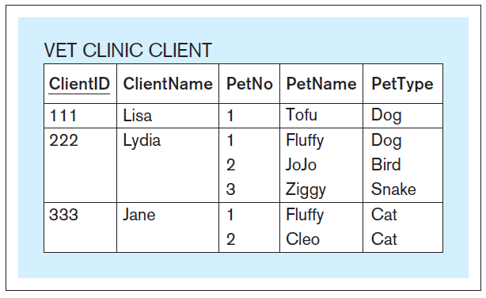
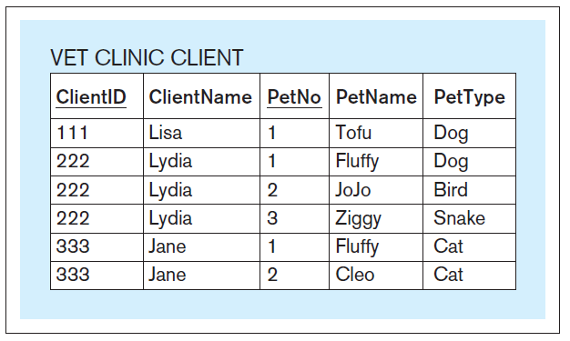
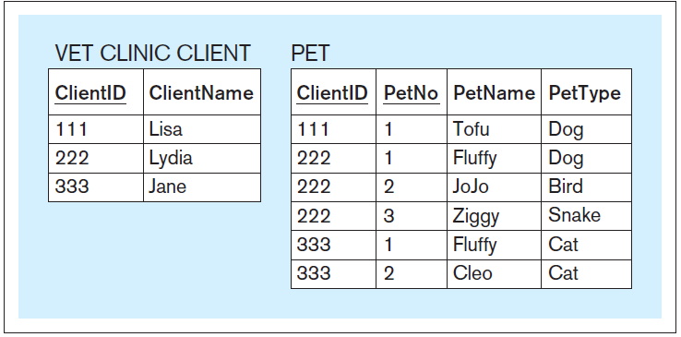
First Normal Form (1NF), cont’d
Increase record count
Introduce new table
Database Systems
by Jukić, Vrbsky, & Nestorov
Pearson 2014
ISBN 978-0-13-257567-6

Slide 42
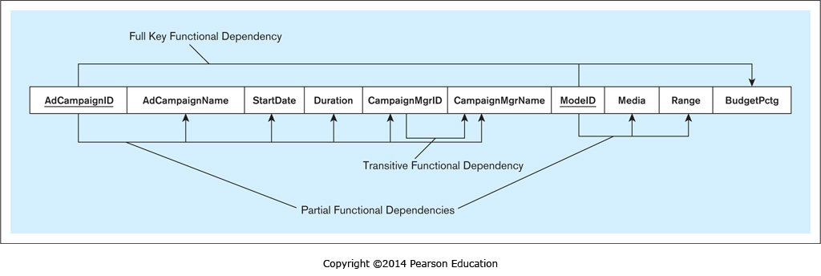
Second Normal Form (2NF)
A table is in 2NF if:
It is in 1NF.
It does not contain partial functional dependencies.

Slide 43
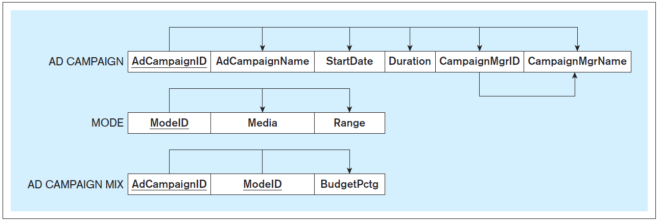
Second Normal Form (2NF), cont’d
Database Systems
by Jukić, Vrbsky, & Nestorov
Pearson 2014
ISBN 978-0-13-257567-6

Slide 44
Third Normal Form (3NF)
A table is in 3NF if:
It is in 2NF.
It does not contain transitive functional dependencies.
Database Systems
by Jukić, Vrbsky, & Nestorov
Pearson 2014
ISBN 978-0-13-257567-6

Slide 45
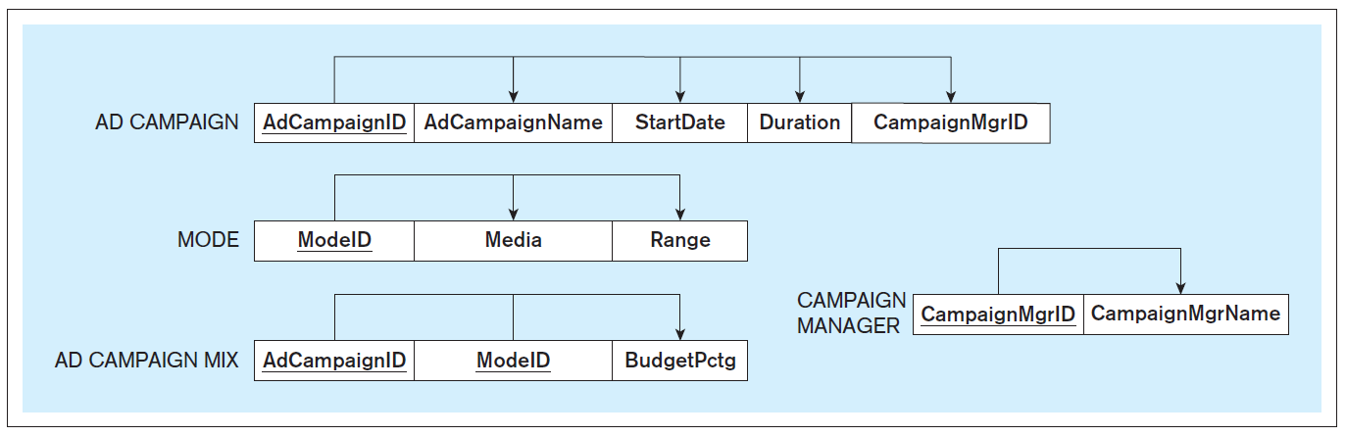
Third Normal Form (3NF), cont’d
Database Systems
by Jukić, Vrbsky, & Nestorov
Pearson 2014
ISBN 978-0-13-257567-6
Note that a copy
of the determinant
is left behind.

Slide 46
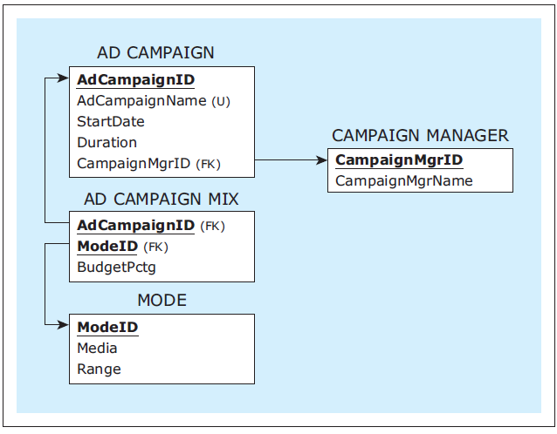
Third Normal Form (3NF), cont’d
Database Systems
by Jukić, Vrbsky, & Nestorov
Pearson 2014
ISBN 978-0-13-257567-6

Slide 47
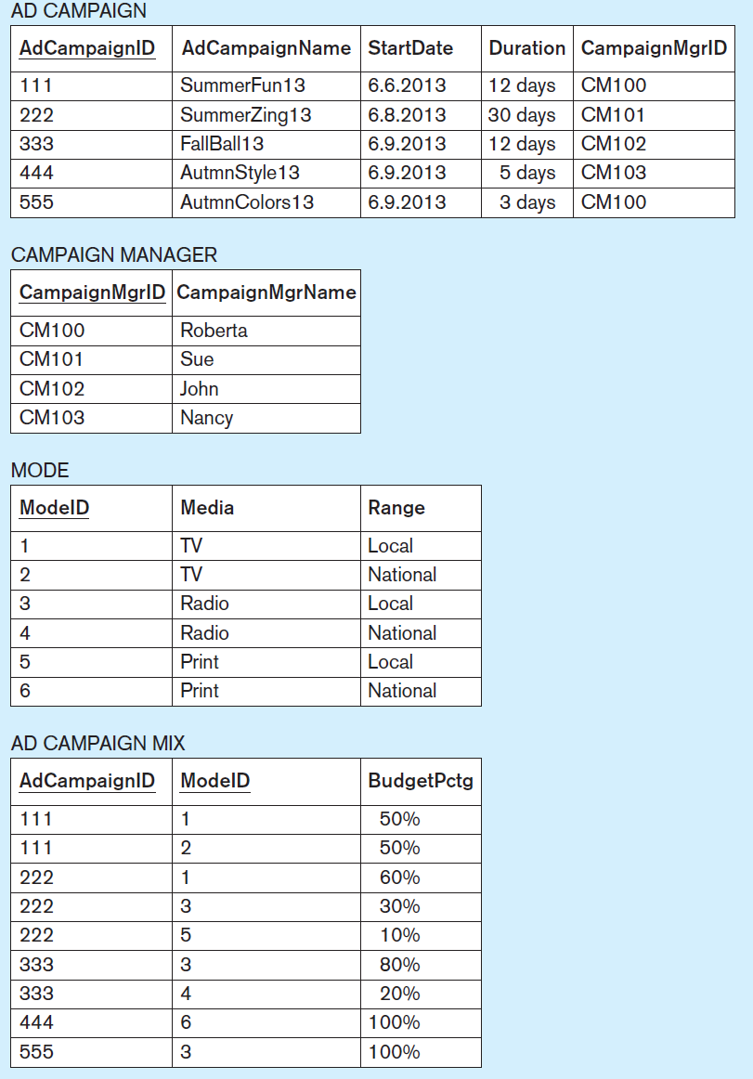
Third Normal Form (3NF), cont’d
Database Systems
by Jukić, Vrbsky, & Nestorov
Pearson 2014
ISBN 978-0-13-257567-6

Slide 48
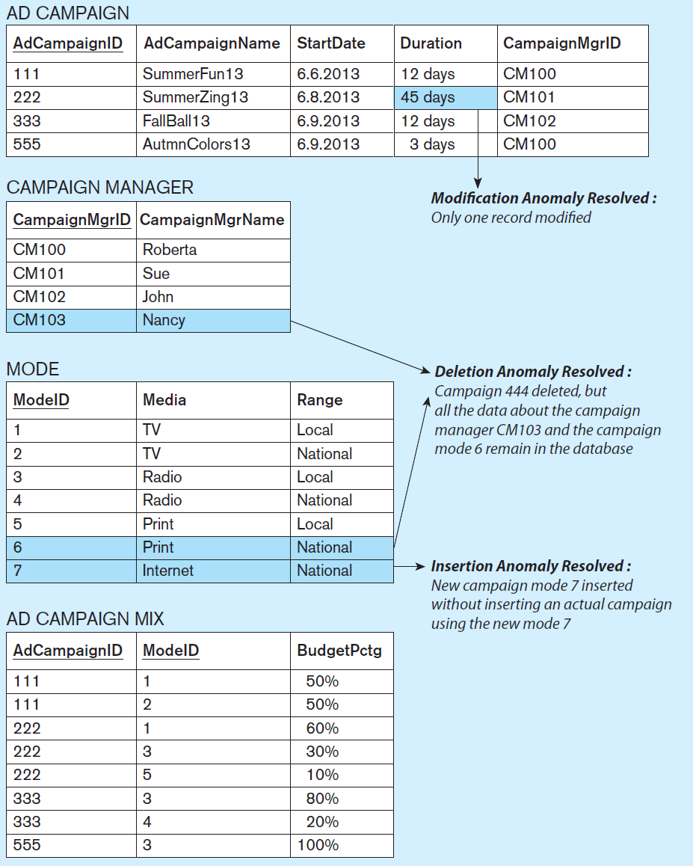
Third Normal Form (3NF), cont’d
Original unnormalized table
Database Systems
by Jukić, Vrbsky, & Nestorov
Pearson 2014
ISBN 978-0-13-257567-6

Slide 49
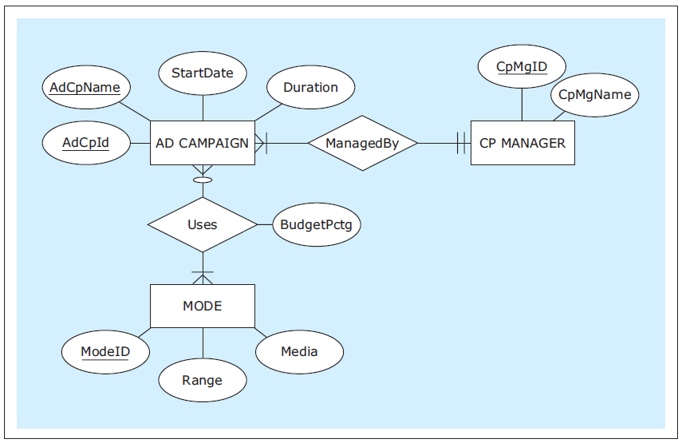
ER Diagram Normalization Technique
Create a proper ER diagram from the table:
Database Systems
by Jukić, Vrbsky, & Nestorov
Pearson 2014
ISBN 978-0-13-257567-6

Slide 50
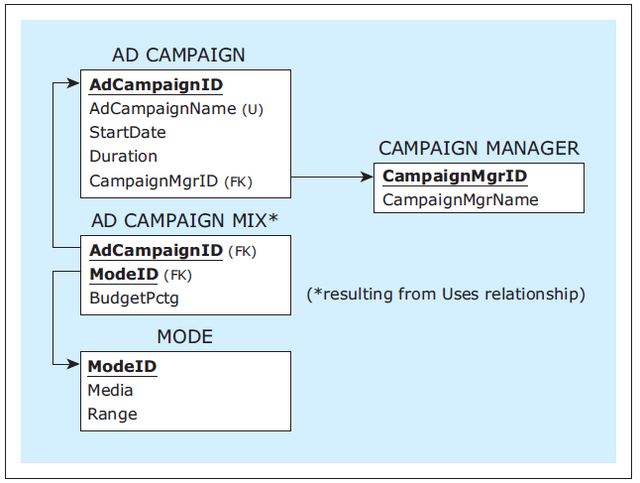
ER Diagram Normalization Technique, cont’d
Map to a relational schema:
Database Systems
by Jukić, Vrbsky, & Nestorov
Pearson 2014
ISBN 978-0-13-257567-6

Slide 51
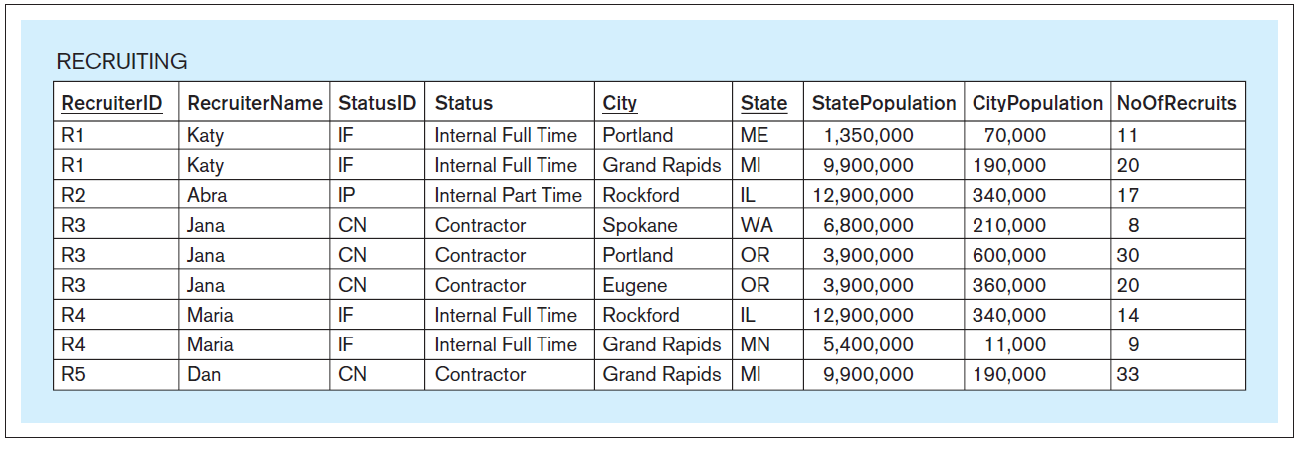
Another Normalization Example
Original table
Functional dependencies:
RecruiterID → RecruiterName, StatusID, Status
StatusID → Status
State → StatePopulation
City, State → CityPopulation
RecruiterID, City, State → NoOfRecruits
Can you spot the functional dependencies?
Database Systems
by Jukić, Vrbsky, & Nestorov
Pearson 2014
ISBN 978-0-13-257567-6

Slide 52




Another Normalization Example, cont’d
Functional dependencies:
RecruiterID → RecruiterName, StatusID, Status
StatusID → Status
State → StatePopulation
City, State → CityPopulation
RecruiterID, City, State → NoOfRecruits
full key
RecruiterID
RecruiterName
StatusID
Status
City
State
StatePopulation
CityPopulation
NoOfRecruits
partial
partial
partial
2NF
Database Systems
by Jukić, Vrbsky, & Nestorov
Pearson 2014
ISBN 978-0-13-257567-6

Slide 53
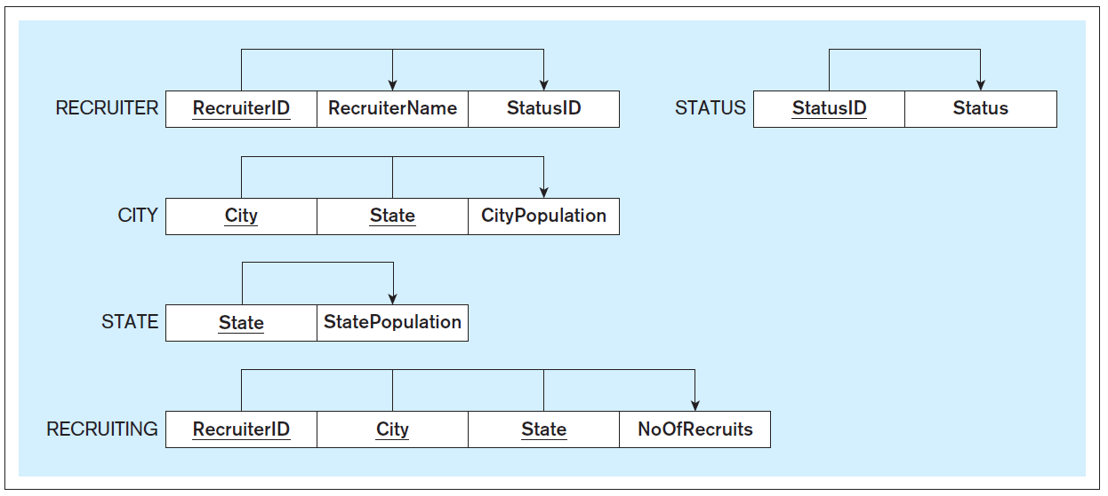
Another Normalization Example, cont’d
transitive
RecruiterID
RecruiterName
StatusID
Status
City
State
StatePopulation
CityPopulation
NoOfRecruits
Partial: RecruiterID → RecruiterName, StatusID, Status
Partial: City, State → CityPopulation
Partial: State → StatePopulation
Full key: RecruiterID, City, State → NoOfRecruits
Transitive: StatusID → Status
3NF
Database Systems
by Jukić, Vrbsky, & Nestorov
Pearson 2014
ISBN 978-0-13-257567-6

Slide 54
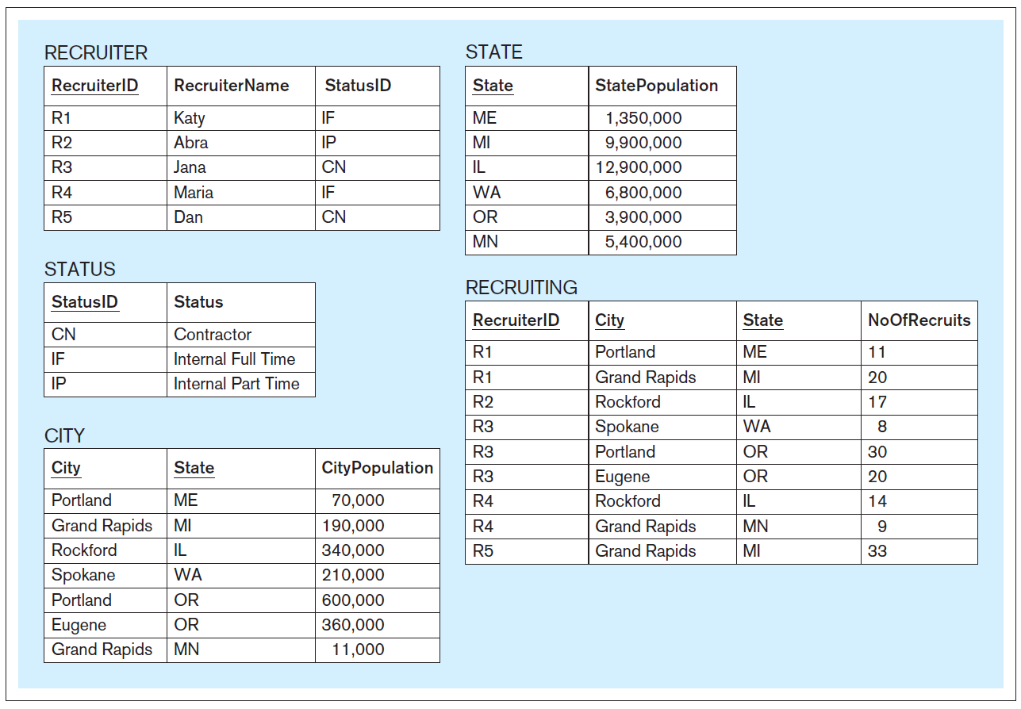
Another Normalization Example, cont’d
Normalized
tables
Database Systems
by Jukić, Vrbsky, & Nestorov
Pearson 2014
ISBN 978-0-13-257567-6

Slide 55
Normalization vs. Denormalization
Normalization spreads data out over more tables.
The result is slower performance.
Joining tables can be an expensive operation.
Sometimes it make sense to denormalize in order to improve performance.
It depends on what queries your application makes.

Slide 56
Normalization vs. Denormalization, cont’d
Original table
Suppose the query is to retrieve for each campaign: AdCampaignID, AdCampaignName, CampaignMgrID, CampaignMgrName, ModeID, Media, Range, and BudgetPctg (i.e., no StartDate or Duration).
It is more efficient to retrieve this data from the original table than from the several normalized tables. Joins are expensive!

Slide 57
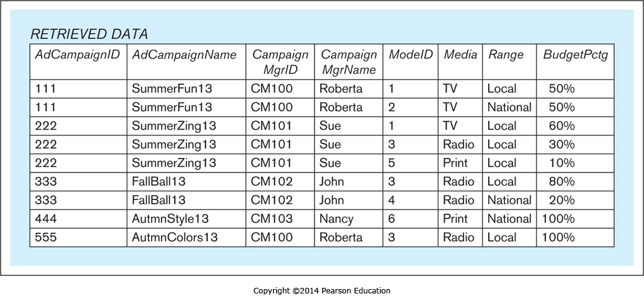
Normalization vs. Denormalization, cont’d
It may be advantageous to keep the original table along with the normalized tables.
Note that the retrieved data is in the form of a table,
but it is not a relational table stored in the database.
Therefore, it’s OK for it to violate constraint rules.
Database Systems
by Jukić, Vrbsky, & Nestorov
Pearson 2014
ISBN 978-0-13-257567-6

Slide 58
Assignment #4: Constraints and Normalization
Individual practice:
finding functional dependencies
normalizing database tables
Teamwork: Add constraints and normalize your team’s database tables

